Slide 1

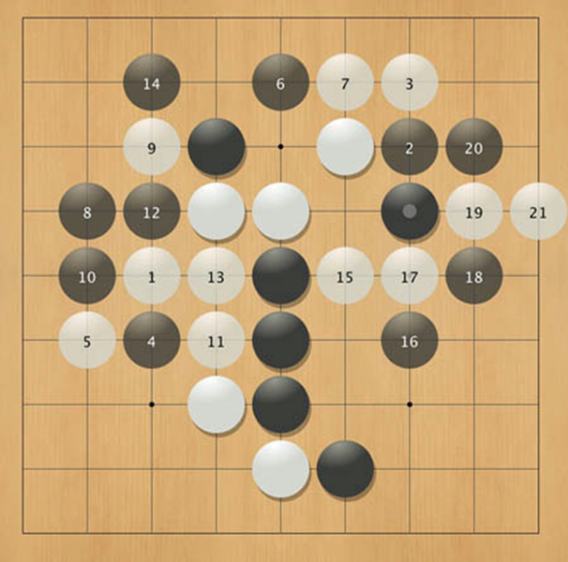
Games Programming
Algorithms & A.I. for Games

Slide 2

Today
Recap: mazes and disjoint sets
Backtracking

Slide 3
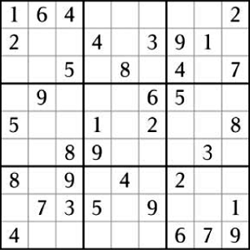
Backtracking

Slide 4
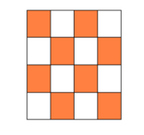
Exercise: N-Queens Problem
How can N Queens be placed on an N x N board in non-attacking position?
There is a solution to the N-Queens problem for all boards of N ≥ 4
Draw a solution to 4-Queens

Slide 5

A solution of 4 queens

Slide 6
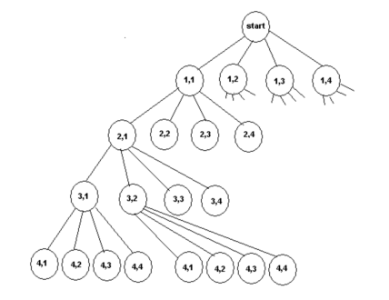
Solve by depth-first search
How many possible solutions to 4-queens?
4 x 4 x 4 x 4 = 256 (N^{N)} candidate solutions
How can we do better?
Notes:
(row, column) where a queen can be placed

Slide 7
Depth-first search template
void dfs(node n)
{
n.visited = true;
for (each Node m adjacent to n)
if (!m.visited)
dfs(m);
}

Slide 8
Definition of Backtracking
Backtracking is a modified depth-first search of a tree consisting of all of the possible sequences that can be constructed from the problem set
In backtracking we perform a depth-first traversal of this tree until we reach a node that is non-viable or non-promising, at which point we "prune the sub tree" rooted at this node, and continue the depth-first traversal of the tree.

Slide 9
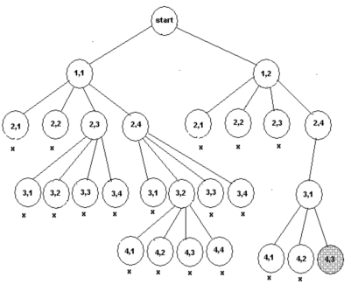
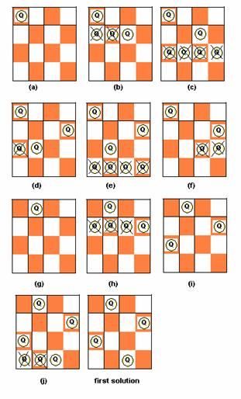
Solve by backtracking

Slide 10
Backtracking pseudo code
void backtrack(node v) {
if (promising(v) )
if (there is a solution at v)
write the solution;
else
for (each child u of v)
backtrack(u);
}

Slide 11
Exercise
Program a backtracking solution to N-Queens
void solveBacktracking(int row)
{
…
}

